Slide 1
WP5 – T5.1 Data source risk assessment in the Surface Web, Deep Web and Dark Nets
Leader: JADS
Partners: AIT, RISSC
Plenary Meeting
Belgrade, Oct. 2018

Slide 2
Agenda
Showcase of task and updated Research Design
Showcase of Analysis Results so far
Content Download & Discussions
Future work plans and TODO’s

Slide 3
Attendees
JADS
ENG
AIT
RISSC

Slide 4
Task Description
Task. This task will focus on the definition of methods and indicators for the risk assessment of new data sources. Risk level is referred to a different aspects strictly connected: on one hand, the risk level is due to the involvement of source in illegal trafficking activities; on the other hand, the possibility that criminal groups that own or manage sources monitored by LEAs could recognise anomalous activities due to the crawling process and block them, compromising the investigations. Taking into account that risk level of a source can increase with its depth in the Web, such methods will then consider the position of the source (in Surface Web, Deep Web or Dark Nets), metadata that can be extracted in order to define which policies should be enabled to perform the crawling and with which degree of anonymity. Finally, websites appearance, their update frequency and refresh in data will be taken into account during the assessment stage. The outcome of this task consists in a set of guidelines, methods and principles to establish the risk level of sources in Surface Web, Deep Web and Dark Nets, and the related policies to be applied for ensuring safe and secure crawling.

Slide 5
Objectives (from Belgrade)
The task will deliver:
Methods and indicators for risk assessment of new data online sources;
Strategies to avoid detection;
Anonymous Crawling Policies
Taxonomy of Criminal Activity Types;
Cyberfootprint indicators;
Notes:
a) Objectives (what each task will actually deliver: an algorithm, a model, a module, the exact functionality, etc.), b) Starting point (be specific on what is already available and ANITA will start working on top of this: existing product, algorithm, dataset, etc.), c) Plan and goals for future research (since the project is a RIA, we need to produce significant research outcomes -including publications-, so please outline what are the research objectives of each task, what is the approach that is going to be followed and what is the plan for the next 6 months).

Slide 6
Objectives (Updated)
The task will deliver:
Methods and indicators for risk assessment of new data online sources;
Strategies to avoid detection;
Anonymous Crawling Policies
Taxonomy of Criminal Activity Types;
Cyberfootprint indicators;
Multi-depth (Shallow, Deep, Dark) Risk Assessment Methods;
+37 papers added to the dataset, incl. Klerx et al. From AIT
Notes:
a) Objectives (what each task will actually deliver: an algorithm, a model, a module, the exact functionality, etc.), b) Starting point (be specific on what is already available and ANITA will start working on top of this: existing product, algorithm, dataset, etc.), c) Plan and goals for future research (since the project is a RIA, we need to produce significant research outcomes -including publications-, so please outline what are the research objectives of each task, what is the approach that is going to be followed and what is the plan for the next 6 months).

Slide 7
Research Design
MRQ. what guidelines, methods, and principles exist to establish cyberthreat level of online sources?
SRQ1. what online depth levels are more assessed?
SRQ2. what degrees of anonymity exist for web-crawling?
SRQ3. what policies exist to vary the degrees of anonymity?
SRQ4. what website features are most indicative of cyberthreats?

Slide 8
Research Design
MRQ. what guidelines, methods, and principles exist to establish cyberthreat level of online sources?
SRQ1. what online depth levels are more assessed?
SRQ2. what degrees of anonymity exist for web-crawling?
SRQ3. what policies exist to vary the degrees of anonymity?
SRQ4. what website features are most indicative of cyberthreats?
SRQ5. what assessment methods exist for which depth of analysis?

Slide 9
Results so far (shallow)

Slide 10
Creating a Dataset Matching the Results
HOW
HOW
WHAT
WHAT
WHAT

Slide 11
Creating a Dataset Matching the Results
WHAT
WHAT
WHAT

Slide 12
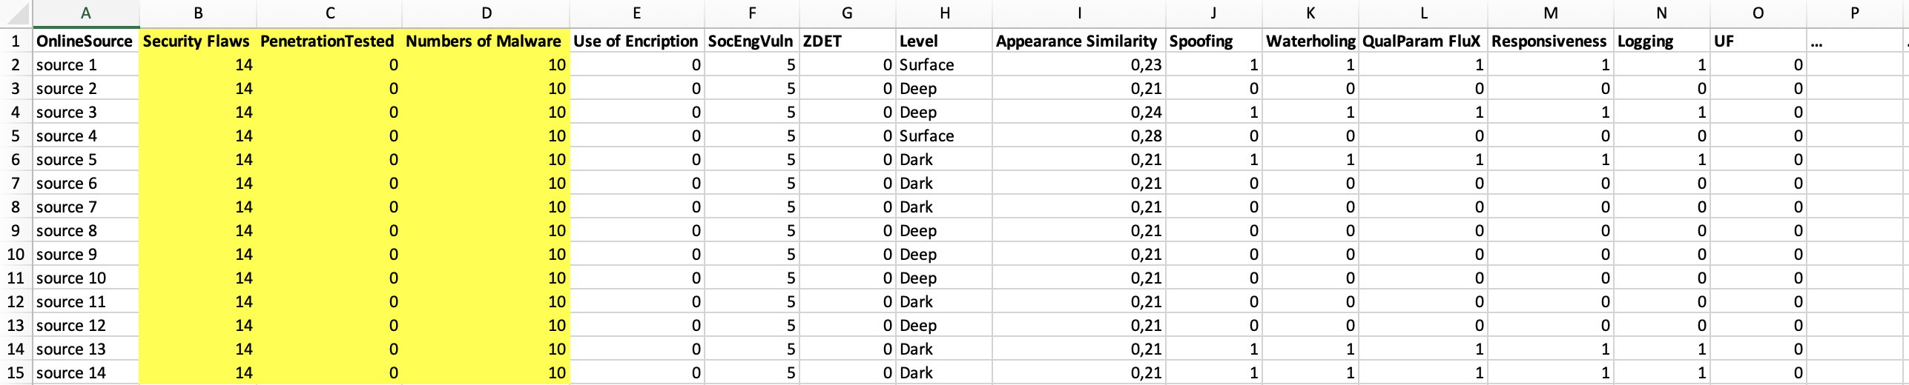
Creating a Dataset Matching the Results

Slide 13
Creating a Dataset Matching the Results
1. We are looking for comprehensive tools that detect known security flaws and vulnerabilities/malware

Slide 14
Security Flaws & Vulnerability Detection SLR

Slide 15
Creating a Dataset Matching the Results
2. We are building a scraper to look for the sources themselves and evaluate them with an early-level observational assessment

Slide 16
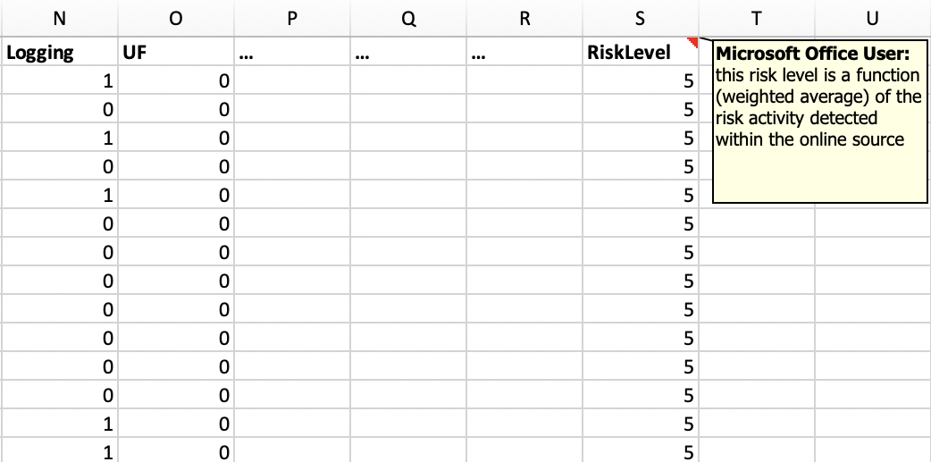
Creating a Dataset Matching the Results
3. We are formalizing a way to transparently assess the level of risk as a function of the criminal activity types reported on the sources and the rest of parameters

Slide 17
Potential risks & Open issues
Risk | Mitigation plan
Lack of overlap with use-case owners | Survey Research To Elicit Quantitative + Qualitative insights from use-case owners
Lack of agreement for provided results | Case-Study or Simulations Research by means of ANITA Use-Cases
Lack of specific indicators for Shallow, deep, and dark-nets | Survey with ANITA use-case owners: https://docs.google.com/forms/d/14xMYz71Vozr4hI73QT7EdjiuHg3VtzpLwjkRvy_lL9w/edit

Slide 18
This risk already manifested!
Risk | Mitigation plan
Lack of overlap with use-case owners | Survey Research To Elicit Quantitative + Qualitative insights from use-case owners
Lack of agreement for provided results | Case-Study or Simulations Research by means of ANITA Use-Cases
Lack of specific indicators for Shallow, deep, and dark-nets | Survey with ANITA use-case owners: https://docs.google.com/forms/d/14xMYz71Vozr4hI73QT7EdjiuHg3VtzpLwjkRvy_lL9w/edit

Slide 19
Questions?
Thank you for your attention

